Slide 1
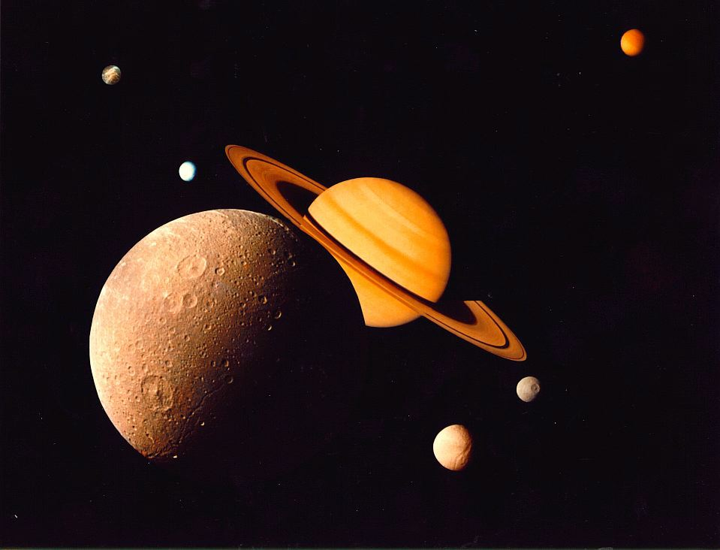
Sizing Up Saturn

Slide 2
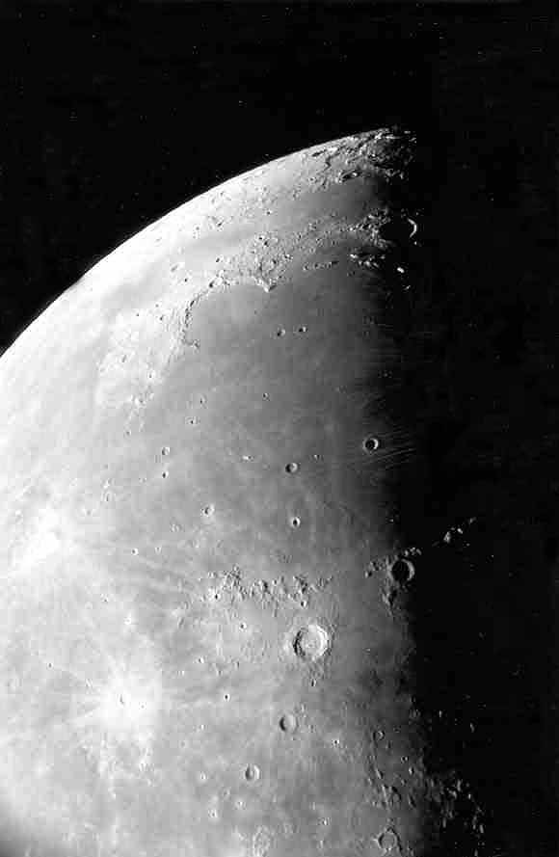
Moon Maré
Moon maria as seen through our telescope.
Photo by
Jim Fullerton

Slide 3
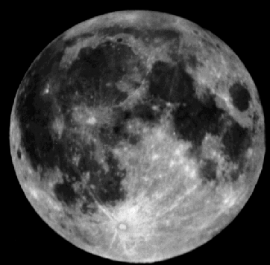
Moon Maré
The maria (maré) are the smooth dark areas on the surface of the Moon.
Mare
Highlands

Slide 4
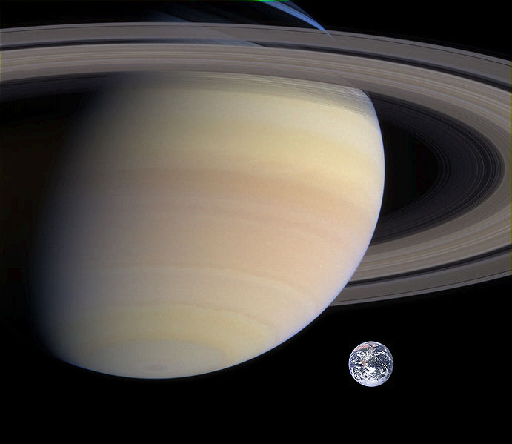

Moon vs. Saturn
Earth
Moon
The Moon is 3.6 times smaller than Earth and 34 times smaller than Saturn!

Slide 5
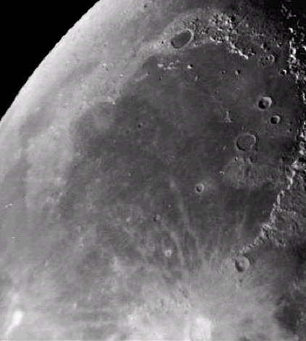
Moon Maré
The maria were formed about 3.2 to 4 billion years ago.
Lava flowed through cracks in the lunar surface and filled in low laying areas. These cracks were NOT developed because of an impact. Scientists are not sure what caused them.
Maré Imbrium

Slide 6
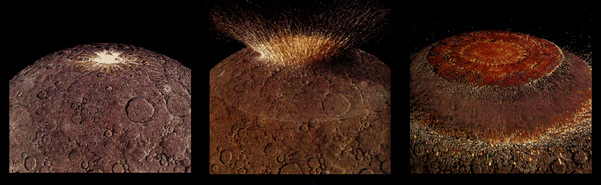
Moon Maré
Four billion years ago the impact of a very large asteroid formed a huge multi-ringed basin which thinned and fractured the lunar crust.

Slide 7
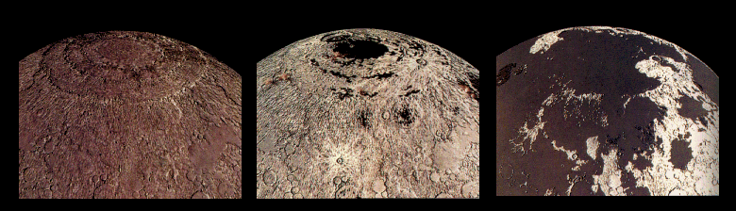
Moon Maré
Thin, lava from beneath the moon’s crust flowed out and flooded the low regions of the lunar surface, filling many existing craters.

Slide 8
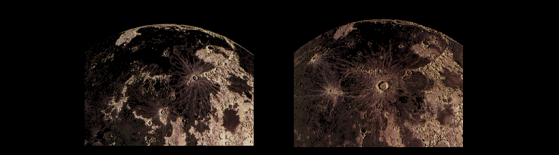
Moon Maré
Less than a billion years after it began, the lava stopped flowing out onto the surface of the Moon and new craters began to form on top of the maria.

Slide 9
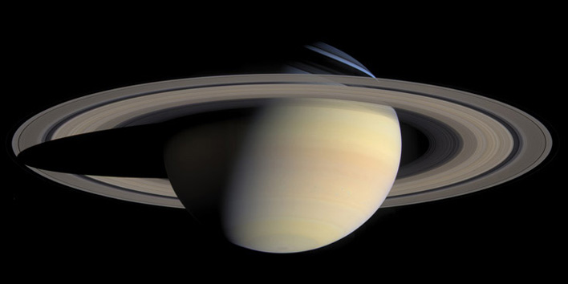
Moon vs. Saturn
Since Saturn doesn’t have a solid surface, you won’t find any of these large smooth areas called maré on it.

Slide 10
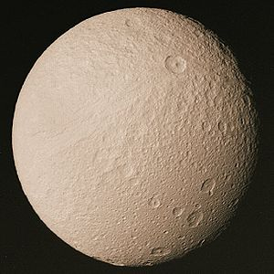
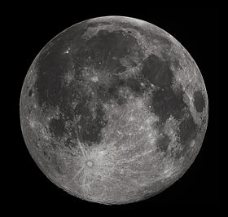
Moon vs. Saturn
Some of Saturn’s medium sized moons have more in common with our Moon …
Tethys
Moon
except water ice takes the place of rock.

Slide 11
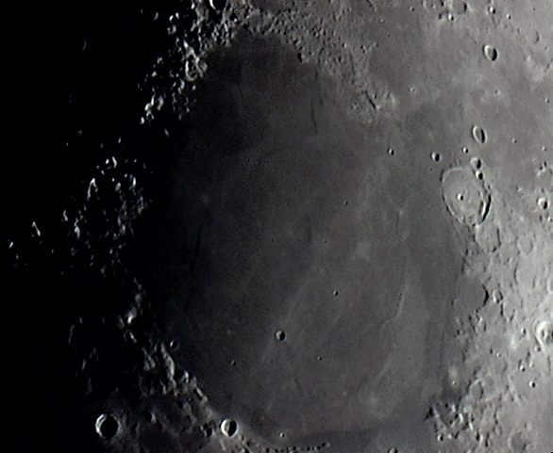
Older & Larger Craters
Mare Imbrium
Mare Serenitatis
Many older, larger craters on the near-side of the Moon have been completely filled with lava – about 31% of the near-side.

Slide 12
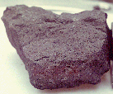
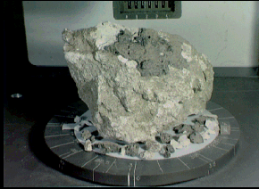
Moon Maré
Lunar rock samples from the moon’s maria are dark colored rocks.
Rock samples from the highland regions are much lighter in color.

Slide 13
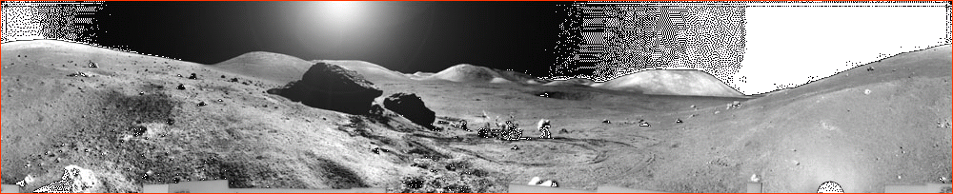
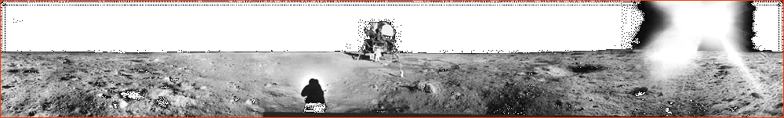
One of these pictures shows the lunar surface from a maré, the other from the highlands.
Can you tell which is which?

Slide 14
Moon Maré
The highlands are rugged.
The maré are relatively smooth and flat.

